Slide 1
Student Learning Objectives
Teacher Orientation
Texas

Slide 2
Objectives
Participants will:
Understand the SLO process as a valid and reliable measure of student growth.
Review all 3 phases of the SLO process through the student growth lens.
Practice writing, editing, and giving feedback on all steps in the SLO process.
2

Slide 3
Framing Questions
How do we know if students are growing in their knowledge and skills?
What evidence will we use to determine students’ beginning skill level, the progress they make throughout the year, and determine their end of year skill level?

Slide 4
SLO Process – 2
Highly structured
Multiple data sources for all three phases of SLO process
Student work as evidence
An alternate student growth measure, based on body of evidence of student work, instead of a pre-test/post-test
Appraiser approval of all three phases of SLO is critical which means appraiser training is critical
4

Slide 5
Student Growth: Using Tests vs. Using a Body of Evidence of Student Work
SLOs
Pre-test/Post-test
Based on a foundational skill
Based on a body of evidence of student work aligned to the skill
Student work from throughout the school year
Multiple data points
Typically based on larger scope of material
Based on how students perform on a test, not on student work
Comparison of beginning and end of year tests
Two data points

Slide 6
Connection to Teacher Growth
Reflective process
On which assignments did students demonstrate the most growth?
How might this reflect instructional practices being used?
How did differentiated student supports align with demonstrated student growth?
Use evidence, reflection, and coaching to make necessary instructional pivots.
6

Slide 7
Highly Structured Process
Level of detail in SLO Skill Statement
Evidence based Initial Skill Profile (ISP)
Evidence used to map students to ISP
Evidence used to set Targeted Growth Goals for each student via the Targeted Skill Profile (TSP)
All of the above approved by trained appraisers at BOY conference
Middle of Year Conference for ongoing support
BOE used at EOY to determine each student’s EOY Skill level
7

Slide 8
Body of Evidence (BOE)
What constitutes a valid BOE?
How aligned is each piece of evidence to the Skill Statement?
How will the BOE be tracked?
Do student work samples measure the skill named in the SLO Skill Statement?
Is there a high degree of alignment to Skill Statement?
8

Slide 9
Core Idea
The Student Learning Objective process is an evidence-based measure of student growth.

Slide 10
Growth vs. Achievement
Downwards arrow indicates change over time
Advanced
Proficient
Upwards arrow indicates change over time
Start of the School Year
End of the School Year
10

Slide 11
Growth vs. Achievement – 2
Pre-set grade level expectations for all
Student Growth Measures
11

Slide 12
The SLO Perspective
The goal of a teacher is to maximize the potential of every student in the classroom.
Student growth is the best indicator of whether teachers are reaching that goal.

Slide 13
Core Idea – 2
To maximize growth, we must know specifically which skills students do or do not have at the beginning of the year.

Slide 14
SLOs are…
An accurate, evidence-based process.
A concentrated look at instructional impact.
Focused on a foundational skill of the course.
Evidence-based.
A means to teacher growth.

Slide 15
Six Big Questions of the SLO Process
How will I guide these students towards growth?
Who are my students?
What is the focus of my SLO?
Did students grow and what did I learn from this process?
Are students progressing towards these targets?
What are my expectations for these students?

Slide 16
Correct Order of SLO Key Questions
What is the focus of my SLO?
Who are my students?
What are my expectations for these students?
How will I guide these students towards growth?
Are they progressing toward their targets?
Did students grow and what did I learn from the process?

Slide 17
Why isn’t “Who are my students?” first?
This isn’t about sorting the cards for order of importance, it’s about sequencing so that we maximize student growth.
We cannot determine where our students are with respect to a foundational skill, without determining what the foundational skill is first.
17

Slide 18
Structure of the Training
Model/Activity/Your Turn
Key Ideas
Success Criteria
Exemplars/Non-exemplars
Practice creating your own
Core Ideas
Key Takeaways
Flexibility and Questions
18

Slide 19
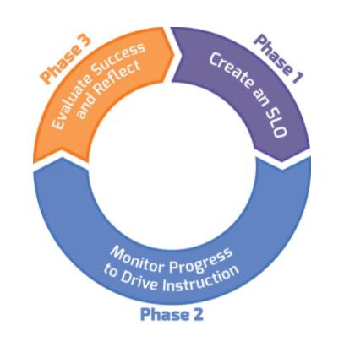
Three Phases of SLO

Slide 20
What we will cover…
Writing Quality SLO Skill Statements
Writing Quality Initial Skill Profiles (ISP)
Matching Students to the ISP
Writing Quality Targeted Skill Profiles(TSP)
SLO Form/Beginning of Year Conference
Collecting a Valid Body of Evidence (BOE)
Student Growth Tracker
SLO Mid-Year Conferences
Determining End of Year Skill Levels Based on BOE
EOY Conferences
20

Slide 21
SLO Skill Statements
What makes a strong Skill Statement?

Slide 22
What is the focus of my SLO?

Slide 23
SLO Skill Statement
The skill statement is a description of what students should be able to do with respect to the foundational skill by the end of the course/year.
23

Slide 24
Creating Skill Statements
Essential Question:
What are the most important skills I teach?

Slide 25
Creating Skill Statements – 2
The Skill Statement:
Emphasizes priority of content.
Aligned to standards for the course
Reinforces foundational skills
TEKS used as a guide, but won’t cover all of them.
Teacher is able to provide clear explanation of the importance of the selected content for the SLO.

Slide 26
Success Criteria for Writing
an Effective Skill Statement
Represents a foundational skill that is specific to the content area
Persists throughout the course
Measurable through a demonstration of student skill
Focus on it will lead to student and teacher growth in this course and beyond
The skills captured are clearly defined and appropriately focused
26

Slide 27
SLO Skill Statements – 2
Non-Example
Example
Students will analyze the Civil War.
Analyze multiple pieces of evidence, including primary documents, to make claims and justify conclusions.

Slide 28
SLO Skill Statements – 3
Success Criteria
Example
Represents a foundational skill that is specific to the content area.
Persists throughout the course.
Measurable through a demonstration of student skill.
Focus on it will lead to student growth in this course and beyond.
The skills captured are clearly defined and appropriately focused.
Analyze multiple pieces of evidence, including primary documents, to make claims and justify conclusions.

Slide 29
SLO Skill Statements – 4
Non-Example
Example
Students use drawing techniques to complete projects.
Use conventions of shading (light and dark) to convey perspective in a pencil/pen sketch.

Slide 30
SLO Skill Statements – 5
Success Criteria
Example
Represents a foundational skill that is specific to the content area.
Persists throughout the course.
Measurable through a demonstration of student skill.
Focus on it will lead to student growth in this course and beyond.
The skills captured are clearly defined and appropriately focused.
Use conventions of shading (light and dark) to convey perspective in a pencil/pen sketch.

Slide 31
SLO Skill Statement Exemplars
Individually (silent/solo) read your assigned Exemplar Skill Statements from each of the three groups of statements on p. 3 of the Teacher Orientation Manual (5 min.)
Be prepared to discuss in groups: (9 min.)
What do you notice?
How does each one align to the Success Criteria?

Slide 32
SLO Skill Statement Non-Exemplars
Individually (silent/solo) read your assigned Non-Exemplar Skill Statements from each of the three groups of statements on p. 4 of the Teacher Orientation Manual. (5 min.)
Be prepared to discuss in small groups (5 min.)
What do you notice?
Where are the gaps in order to align to the Success Criteria?
What probing questions would you ask the teacher in order to strengthen these Skill Statements?

Slide 33
Strengthening Non-Exemplar
Skill Statements
Use Success Criteria as a guide:
Determine where the gap is
Add in what is missing
Use the TEKS to ensure Skill Statement reflects foundational skill

Slide 34
TEKS Connection
§130.254. Culinary Arts (Two Credits), Adopted 2015.
(a) General requirements. This course is recommended for students in Grades 10-12. Recommended prerequisites: Principles of Hospitality and Tourism and Introduction to Culinary Arts. Students shall be awarded two credits for successful completion.
8) The student evaluates and determines equipment, ingredients, and procedures used in a professional food setting. The student is expected to:
(A) identify and demonstrate the role of mise en place in professional food service
(B) identify and use large and small equipment in a commercial kitchen;
(C) develop and practice food production and presentation techniques;
(D) identify and use the appropriate application of moist, dry, and combination cookery methods;
(E) demonstrate the preparation skills of items commonly prepared in food service operations such as breakfast cookery, salads and dressings, soups and sandwiches, stocks and sauces, appetizers, seafood, poultry, meat, pastas and grains, and fruits and vegetables;
(F) demonstrate baking techniques such as yeast breads and rolls, quick breads, and desserts.
34

Slide 35
TEKS Connection – 2
§130.254. Culinary Arts (Two Credits), Adopted 2015.
(a) General requirements. This course is recommended for students in Grades 10-12. Recommended prerequisites: Principles of Hospitality and Tourism and Introduction to Culinary Arts. Students shall be awarded two credits for successful completion.
(12) The student explains how employees, guests, and property are protected to minimize losses or liabilities. The student is expected to:
(A) determine the basics of safety in culinary arts;
(B) assess workplace conditions and identify safety hazards;
(C) determine the basics of sanitation in a professional kitchen;
(D) determine proper receiving, storage, and distribution techniques;
(E) demonstrate proper cleaning of equipment and maintenance in the commercial kitchen;
(F) assess food hazards and determine ways to prevent food hazards; and
(G) prepare for a state or national food sanitation certification or other appropriate certifications.
35

Slide 36
Consult the TEKS as a general guide
SLO Skill Statements are:
Still about a foundational skill of the course.
The most important “bits” of the course.
SLOs are not about all of the TEKS, rather about the most enduring aspects.
36

Slide 37
Core Idea – 3
To produce the greatest depth of learning, the most effective teachers prioritize their time around the foundational knowledge and skills; they don’t chase TEKS.

Slide 38
Strengthening Skill Statements
Before
After
Culinary Arts 101- Students will use proper cooking conditions and follow recipes to prepare nutritionally sound meals.
Students will be able to plan and prepare a nutritionally sound meal, applying industry standard cooking techniques and using American Culinary Federation Education Standards for sanitation and safety.

Slide 39
Strengthening Skill Statements – 2
Before: 3rd Grade Math
After
Students will summarize data with multiple categories using a frequency table, dot plot, pictograph, and bar graph with scale intervals. They will also solve one and two step problems using categorical data represented with a frequency table, dot plot, pictograph, or bar graph with scaled intervals.
Students will be able to recall basic multiplication and division facts with fluency and accuracy and apply their understanding of multiplication and division to solve one and two-step word problems.

Slide 40
Activity – 2
In groups:
Select one of the three non-exemplar skill statements you reviewed previously.
As a group, strengthen it to align with the Success Criteria.
Prepare to share your before/after versions and rationale in whole group.
40

Slide 41
A Resource to Review (and use later!)
You can find the full list of revised Skill Statements in the Google drive, and also in the chat. Take a few minutes to review.
What do you notice about the revised skill statements compared to their original non-exemplar format?
41
Notes:
3 min.
Point participants’ attention to the “Revised Skill Statements” document shared on the previous slide. This is a resource for later. The point here is to point out the resource, make sure they have access to it, and allow them to become familiar with the document overall. They won’t have time to read the whole thing right now. Remind them that this is a resource for later.
Give participants 3 minutes to review the list of revised SLO Skill Statements. Address any questions or comments in the chat.

Slide 42
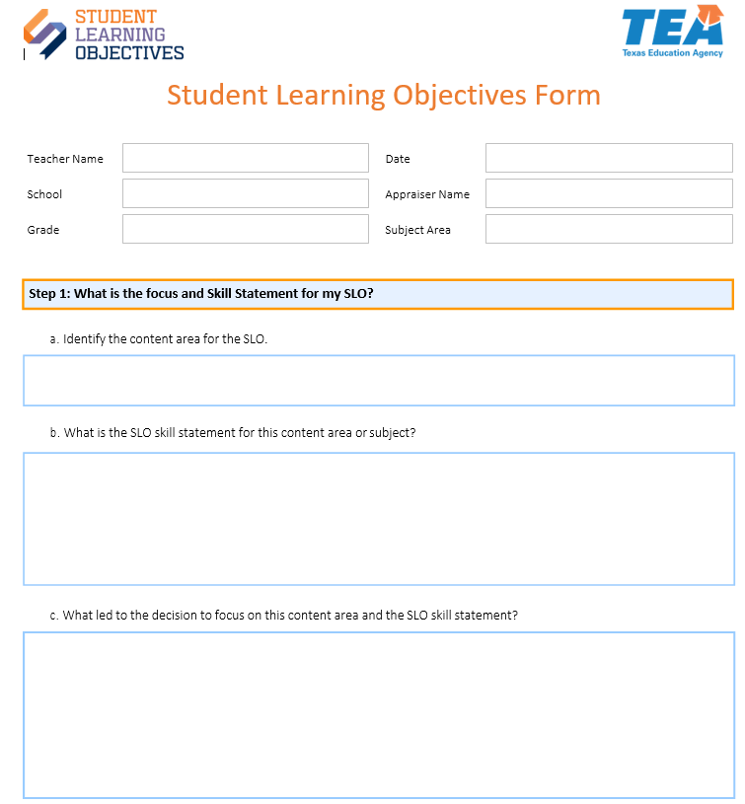
Student Learning Objectives Form
Use a blank SLO Form to record your Skill Statement.

Slide 43
Your Turn!
Using either the last subject you taught, or your favorite subject, write an SLO Skill Statement that aligns to the Success Criteria.
(7 minutes)
Hint: look up the TEKS for your course to get started!
TEKS main site
Be prepared to share.
The Skill Statement you create will be the basis of your work for the rest of this training.
43

Slide 44
Logistics - Year One
When do I determine the content area and focus for my SLO?
At the beginning of the year after SLO teacher orientation
When do I write my SLO Skill Statement?
During the first few weeks of school

Slide 45
Logistics - Years Two and Beyond
When do I determine the content area for my SLO?
During my End-of-Year Conference when mapping out my goal-setting and professional development plan.
When do I determine the skill focus for my SLO?
Before school starts or immediately after school begins.
When do I write my Skill Statement?
During the first few weeks of school.

Slide 46
Reflections – 2
What are your key takeaways from this section of the SLO?

Slide 47
Key Takeaways – 2
Skill statements should narrow the focus for the SLO.
Foundational skills vs TEKS chasing
Success criteria provide guidance

Slide 48
Initial Skill Profile Section
What makes a strong Initial Skill Profile?

Slide 49
Core Idea – 4
The most effective teachers teach the students they have, not the students they think they’ll have.

Slide 50
Who are my students?

Slide 51
Who are my students?
There are two different parts in this section:
What do I expect my students will be able to do with this skill statement, based on what is typical in my experience?
What are my students actually able to do, based on multiple data points?

Slide 52
Creating an Initial Skill Profile
An Initial Skill Profile (ISP):
Is a skill progression rubric.
Describes different levels of student proficiency with respect to the foundational skill.
Begins with what a student “typically” knows and can do when they walk in the door at the beginning of the year (with respect to the skill selected for the SLO).

Slide 53
Success Criteria for Writing an Effective Initial Skill Profile
Articulates skills for the beginning of the year
Differentiates between levels
Descriptors align to skill statement
Can be assessed in multiple ways
Based on multiple sources of evidence/a teacher’s experience
53

Slide 54
Initial Skill Profile: Exemplar
Skill Statement 8th ELA: Students will be able to draw accurate conclusions supported by appropriate textual evidence from informational texts
Level | Descriptors
Well above typical skill | Students can summarize the most significant information with informational texts, consistently make accurate inferences, and can often connect inferences with appropriate textual evidence, although written explanation of evidence is often weak or underdeveloped.
Above typical skill | Students can summarize the most significant information with informational texts and often make accurate inferences, although they struggle to connect inferences with appropriate textual evidence.
Typical skill | Students can comprehend informational texts with consistent success summarizing the most significant information, although students often fail to make accurate inferences.

Slide 55
Initial Skill Profile: Exemplar – 2
Skill Statement 8th ELA: Students will be able to draw accurate conclusions supported by appropriate textual evidence from informational texts
Level | Descriptors
Typical skill | Students can comprehend informational texts with consistent success summarizing the most significant information, although students often fail to make accurate inferences.
Below typical skill | Students can comprehend informational texts but struggle to summarize the most significant information.
Well below typical skill | Students struggle to comprehend informational texts and are generally unable to summarize the most significant information.

Slide 56
Initial Skill Profile
Skill Statement 8th ELA: Students will be able to draw accurate conclusions supported by appropriate textual evidence from informational texts
Success Criteria of an ISP
Articulates skills for the beginning of the year
Differentiates between levels
Descriptors align to skill statement (potentially through subskills)
Can be assessed in multiple ways
Based on multiple sources of evidence/a teacher’s experience
Partial ISP | Skill Descriptors
Above typical Skill | Students can summarize the most significant information with informational texts and often make accurate inferences, although they struggle to connect inferences with appropriate textual evidence.
Typical Skill | Students can comprehend informational texts with consistent success summarizing the most significant information, although students often fail to make accurate inferences.
56

Slide 57
Initial Skill Profile Exemplar – 3
Skill Statement Culinary Arts I: Students will be able to plan and prepare food commonly served in food service operations,(aligned to USDA standards) applying industry standard cooking techniques and using American Culinary Federation Education Standards for sanitation and safety.
Level | Descriptors
Well above typical skill | Students have considerable experience with cooking and report often helping to cook the family meals, including cooking some dishes independently. Students are familiar with cooking techniques and safety standards.
Above typical skill | Students have cooked one or two dishes independently and sometime assist in cooking family meals. Students are aware of some cooking techniques and safety standards
Typical skill | Students have some cooking experience, typically assisting family members as they prepare meals, but have not cooked independently. Students with prompting can recognize basic cooking techniques and safety standards.

Slide 58
Initial Skill Profile – 3
Skill Statement Culinary Arts I: Students will be able to plan and prepare food commonly served in food service operations,(aligned to USDA standards) applying industry standard cooking techniques and using American Culinary Federation Education Standards for sanitation and safety.
Level | Descriptors
Typical skill | Students have some cooking experience, typically assisting family members as they prepare meals, but have not cooked independently. Students with prompting can recognize basic cooking techniques and safety standards.
Below Typical skill | Students have a little cooking experience, typically with prepared foods/cake mixes/refrigerated cookie dough, etc. Students are not aware of most basic cooking techniques but recognize some basic safety standards.
Well Below Typical skill | Students have no cooking experience and are not aware of basic cooking techniques or safety standards.

Slide 59
Initial Skill Profile – 4
Skill Statement Culinary Arts I: Students will be able to plan and prepare food commonly served in food service operations,(aligned to USDA standards) applying industry standard cooking techniques and using American Culinary Federation Education Standards for sanitation and safety
Success Criteria of an ISP
Articulates skills for the beginning of the year
Differentiates between levels
Descriptors align to skill statement
Can be assessed in multiple ways
Based on multiple sources of evidence/a teacher’s experience
Partial ISP
Typical Skill | Students have some cooking experience, typically assisting family members as they prepare meals, but have not cooked independently. Students with prompting can recognize basic cooking techniques and some safety standards
Below Typical Skill | Students have a little cooking experience, typically with prepared foods/cake mixes/refrigerated cookie dough, etc. Students are not aware of most basic cooking techniques or safety standards.
59

Slide 60
Initial Skill Profile Non-Exemplars
Individually (silent/solo) read your assigned Non-Exemplar ISP.
Be prepared to discuss in groups:
What do you notice?
Where are the gaps in order to align to the Success Criteria?
What probing questions would you ask the teacher in order to strengthen these ISPs?

Slide 61
Revising a Non-Exemplar ISP: 3rd Grade Math
Where are the gaps?
How can you align better to the skill statement?
How can you make it clearly measurable?
61

Slide 62
One Example: Revised 3rd Grade Math ISP
Skill Statement: Students will be able to recall basic multiplication and division facts with fluency and accuracy and apply their understanding of multiplication and division to solve one and two-step word problems.
Level | Descriptors
Well Above Typical Skill | Students can multiply independently but are not able to use multiplication skills to solve one or two step word problems.
Above Typical Skill | Students can add and subtract four-digit numbers with accuracy and multiply some numbers independently, without support
Typical skill | Students can add and subtract four-digit numbers with accuracy and multiply some numbers when given support like manipulatives.
Below Typical Skill | Students can add and subtract four-digit numbers with difficulty and often without accuracy. Students understand groupings of numbers but cannot multiply numbers.
Well Below Typical Skill | Students can add four-digit numbers but struggle with subtraction and regrouping.
62

Slide 63
Changes from Non-Exemplar to Revised Version
Revised Version of ISP:
Descriptors for each level align to the skill statement.
Specific tasks are mentioned.
The skill level/tasks are measurable in multiple ways.
Each level specifies increasing level of measurable skill.
Progression from each level to the next makes sense.
63

Slide 64
A Resource to Review (and use later!) – 2
Review list of Revised ISPs
What do you notice about the revised ISPs compared to the original non-exemplar format?
64

Slide 65
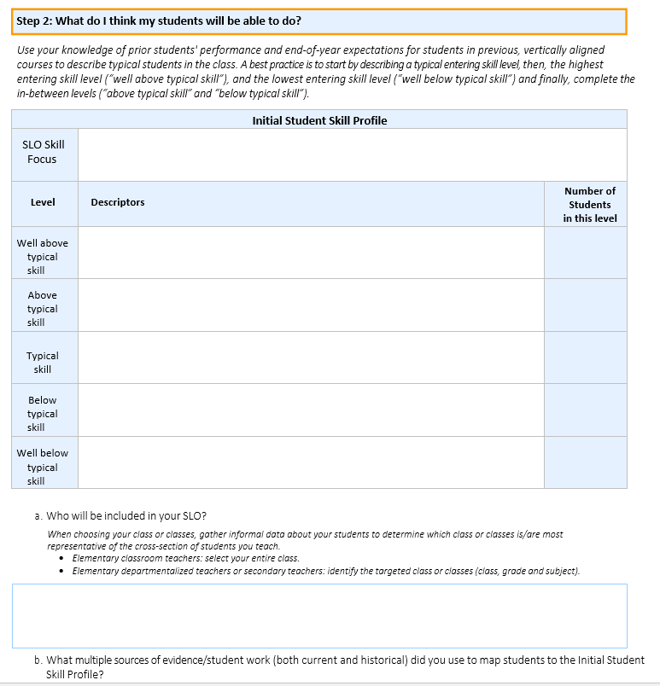
Step 2: What do I think my students will be able to do?

Slide 66
Your Turn! – 2
On your own and using the SLO Skill statement you wrote this morning, create an Initial Skill Profile.
Record on the SLO Form.
You will have 15 minutes.
Hint: Use the TEKS! TEKS main site
Hint: Use the Success Criteria.
We will select a few to share, with permission.
You will use the ISP you create for during the next part of the training.
66

Slide 67
Success Criteria for Writing an Effective Initial Skill Profile – 2
Articulates skills for the beginning of the year
Differentiates between levels
Descriptors align to skill statement
Can be assessed in multiple ways
Based on multiple sources of evidence/a teacher’s experience
67

Slide 68
Reflections – 3
What are your key takeaways from this section on writing a quality Initial Skill Profile?

Slide 69
Matching Students to the ISP
How do you determine which students fall into which entering skill levels?

Slide 70
Who are my students? – 2
There are two different parts in this section:
What do I expect my students will be able to do with this skill statement, based on what is typical in my experience?
What are my students actually able to do, based on multiple data points?

Slide 71
Who are my students? – 3
We collect data about our current students’ skill level in order to assess current level of learning and map to the Initial Skill Profile.

Slide 72
Who are my students? – 4
Timeline for writing ISP and collecting skill level data
*Depending on date of teacher SLO orientation
Year 1 | Year 2 and Beyond
First 6 - 9 weeks* | First 4-6 weeks

Slide 73
Students’ Entering Skill Levels
Match Students to the ISP
Where are students in relation to the Skill Statement?
Use multiple sources of data to determine each student’s entering skill level.
Use current and historical data
To which skill level descriptor on the ISP does each student’s entering skill level most closely correspond?

Slide 74
Core Idea – 5
The most effective teachers teach the students they have, not the students they think they’ll have.

Slide 75
Who are my students? – 5
8th Grade ELA Skill Statement: Students will be able to draw accurate conclusions supported by appropriate textual evidence from informational texts.
The teacher gave five types of assessments to capture her students’ BOY skill levels
Each type was scored on five-point scale
Measures included (with grade-level informational texts):
Multiple choice passages (comprehend )
Response to a prompt (summarize)
Short answers (comprehend, textual evidence)
Analysis essay (inferencing, textual evidence)
Free Write (connect inferences to textual evidence)

Slide 76
What are my students’ BOY skill levels?
Student | Multiple Choice | Prompt Response | Short Answers | Analysis Essay | Free Write | Level
Maria | 5 | 4 | 4 | 4 | 4
Kendrick | 4 | 3 | 3 | 3 | 2
Felipe | 4 | 4 | 4 | 3 | 3
Dayana | 3 | 2 | 1 | 1 | 1
Violet | 3 | 3 | 2 | 2 | 1
76

Slide 77
Who are my students? – 6
Use a preponderance of evidence when matching students to the ISP.
Just because they are placed in the same level doesn’t mean they have the same exact skill set.
Focus on accuracy versus precision.
77

Slide 78
Activity – 4
In your Teacher Orientation Manual use:
3rd grade math ISP - p. 11
3rd grade math ISP student work samples - p. 13-22
Using the student work, map the students’ BOY skill levels to the ISP based on the skills their work demonstrates.
78

Slide 79
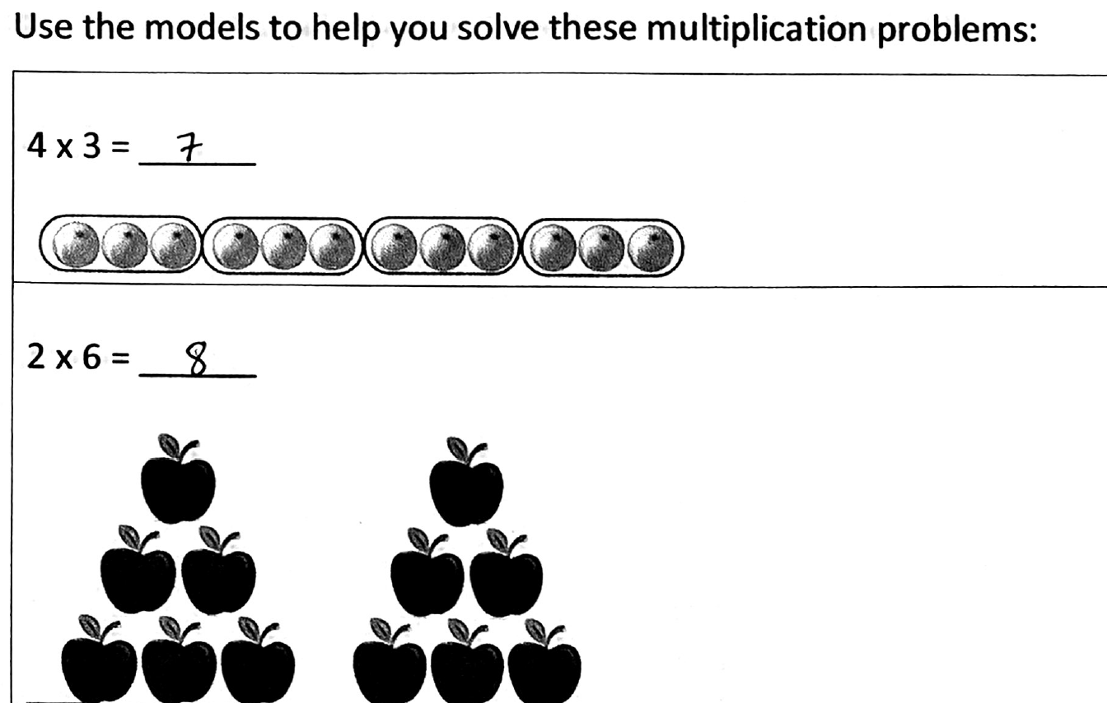
Use the student work to place students
79
Notes:
.

Slide 80
Where would you place the students?
 | Add 4-digit numbers (Problem #7) | Subtract 4-digit numbers (Problem #9) | Regrouping (Problems #8 and #10) | Multiplication when given manipulatives(1st 3 problems) | Multiplication without manipulatives (2nd 3 problems)
Elias
Vanessa
Josh
Reina
Maria
3rd Grade Math Students’ ISP Levels
80

Slide 81
SLO Skill Focus
SLO Skill Focus | SLO Skill Focus: Students will be able to recall basic multiplication and division facts with fluency and accuracy and apply their understanding of multiplication and division to solve one and two-step word problems.
Level | Descriptors | Students in this level
Well above typical skill | Students can multiply independently but are not able to use multiplication skills to solve one or two step word problems. | Josh
Above typical skill | Students can add and subtract four-digit numbers with accuracy and multiply some numbers independently, without support | Maria
Typical skill | Students can add and subtract four-digit numbers with accuracy and multiply some numbers when given support like manipulatives. | Vanessa
Below typical skill | Students can add and subtract four-digit numbers with difficulty and often without accuracy. Students understand groupings of numbers but cannot multiply numbers. | Reina
Well below typical skill | Students can add four-digit numbers but struggle with subtraction and regrouping. | Elias
81

Slide 82
Share Your Learning
Discuss the following two questions:
What is the purpose of the ISP?
How can having baseline information about student skill levels assist teachers to support student growth?
How can this data help appraisers, coaches, and colleagues in teacher growth conversations?

Slide 83
Share Your Learning – 2
What is the purpose of the ISP?
To make evidence-based decisions about students’ entering skill levels.
How can having baseline information about student skill levels assist teachers to support student growth?
Knowing student skill levels, how they apply skills as well as how they approach tasks, is key to effective instructional planning
How can this data help appraisers, coaches, and colleagues in teacher growth conversations appraisers?
Bases a teacher’s approach and conversations about that approach in concrete evidence

Slide 84
Reflections – 4
What are your key takeaways from this section on mapping students to the ISP?

Slide 85
Day 2

Slide 86
Day 2 – 2
Writing Quality SLO Skill Statements
Writing Quality Initial Skill Profiles (ISP)
Matching Students to the ISP
Writing Quality Targeted Skill Profiles(TSP)
SLO Form/Beginning of Year Conference
Collecting a Valid Body of Evidence (BOE)
Student Growth Tracker
SLO Mid-Year Conferences
Determining End of Year Skill Levels Based on BOE
EOY Conferences
86

Slide 87
A Takeaway From Day 1…
Writing Quality SLO Skill Statements
Writing Quality Initial Skill Profiles (ISP)
Matching Students to the ISP

Slide 88
The Targeted Skill Profile (TSP)
Based on multiple data points, what growth goals do I want to set for my students?

Slide 89
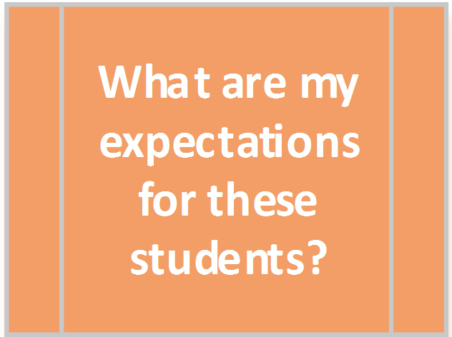
What are my expectations for these students?

Slide 90
Targeted Skill Profiles
The Initial Skill Profile captures students as they arrive in your class prior to your instruction.
The Targeted Skill Profile describes what you expect of students at the end of the SLO.
They are NOT the same.

Slide 91
Targeted Skill Profiles – 2
The Targeted Skill Profile captures the skill levels of where you think your students will be at the end of the year.
Targeted Skill Profiles (TSP):
Are a means for considering long term goals for students
Are based on the distribution of skills seen in the students who you have in the class
Describe what skill level your students should display at the end of the course

Slide 92
Core Idea – 6
Classroom and campus cultures that make some of the biggest gains in student growth do so by moving their focus from “what was taught” to “what was learned.”

Slide 93
Success Criteria for Writing an Effective Targeted Skill Profile
Articulates skills for the end of the year
Differentiates between levels
Descriptors align to skill statement
Can be assessed in multiple ways
Targets are specific to the students in the teacher’s class and based on multiple sources of evidence
Reflects high, yet reasonable expectations for student growth
93

Slide 94
Targeted Skill Profile: Exemplar
8th Grade ELA Skill Statement: Students will be able to draw accurate conclusions supported by appropriate textual evidence from informational texts
Well Above Typical Skill | Students can draw accurate conclusions from above grade-level informational texts and support conclusions with optimal evidence that deepens conclusions.
Above Typical Skill | Students can draw accurate conclusions from above grade-level informational texts and support conclusions with appropriate although not always optimal evidence.
Typical Skill | Students can draw accurate conclusions from grade level informational texts and support conclusions with appropriate although not always optimal evidence.
Below Typical Skill | Students can draw accurate conclusions most of the time from grade-level informational texts and attempt to support conclusions with textual evidence, but the evidence isn’t always appropriate.
Well Below Typical Skill | Students can draw accurate conclusions some of the time from grade-level informational texts, but don’t attempt to support conclusions or, when prompted, support conclusions with inappropriate evidence.
94

Slide 95
Key Differences: TSP & ISP
Read TSP on p. 25 - Teacher Orientation Manual
Compare with the ISP on p. 6
Consider questions and jot thoughts on p. 50:
What are some key differences between the ISP for this course and the TSP?
How does this TSP align to the Success Criteria for a TSP?

Slide 96
Targeted Skill Profile
Skill Statement 8th ELA: Students will be able to draw accurate conclusions supported by appropriate textual evidence from informational texts
Success Criteria of a TSP
Articulates skills for the end of the year
Differentiates between levels
Descriptors align to skill statement
Can be assessed in multiple ways
Targets are specific to the students in the teacher’s class and based on multiple sources of evidence
Reflects high, yet reasonable expectations for student growth
Partial TSP | Skill Descriptors
Above Typical Skill | Students can draw accurate conclusions from above grade-level informational texts and support conclusions with appropriate although not always optimal evidence.
Typical Skill | Students can draw accurate conclusions from grade level informational texts and support conclusions with appropriate although not always optimal evidence.
96

Slide 97
Targeted Skill Profile – 3
Skill Statement 8th ELA: Students will be able to draw accurate conclusions supported by appropriate textual evidence from informational texts
Success Criteria of a TSP
Articulates skills for the end of the year
Differentiates between levels
Descriptors align to skill statement
Can be assessed in multiple ways
Targets are specific to the students in the teacher’s class and based on multiple sources of evidence
Reflects high, yet reasonable expectations for student growth
Partial TSP | Skill Descriptors
Above Typical Skill | Students can draw accurate conclusions from above grade-level informational texts and support conclusions with appropriate although not always optimal evidence.
Typical Skill | Students can draw accurate conclusions from grade level informational texts and support conclusions with appropriate although not always optimal evidence.
97

Slide 98
Targeted Skill Profile – 4
Skill Statement 8th ELA: Students will be able to draw accurate conclusions supported by appropriate textual evidence from informational texts
Success Criteria of a TSP
Articulates skills for the end of the year
Differentiates between levels
Descriptors align to skill statement
Can be assessed in multiple ways
Targets are specific to the students in the teacher’s class and based on multiple sources of evidence
Reflects high, yet reasonable expectations for student growth
Partial TSP | Skill Descriptors
Below Typical Skill | Students can draw accurate conclusions most of the time from grade-level informational texts and attempt to support conclusions with textual evidence, but the evidence isn’t always appropriate.
Well Below Typical Skill | Students can draw accurate conclusions some of the time from grade-level informational texts, but don’t attempt to support conclusions or, when prompted, support conclusions with inappropriate evidence.
98

Slide 99
Targeted Skill Profile – 5
Skill Statement 8th ELA: Students will be able to draw accurate conclusions supported by appropriate textual evidence from informational texts
Success Criteria of a TSP
Articulates skills for the end of the year
Differentiates between levels
Descriptors align to skill statement
Can be assessed in multiple ways
Targets are specific to the students in the teacher’s class and based on multiple sources of evidence
Reflects high, yet reasonable expectations for student growth
Partial TSP | Skill Descriptors
Below Typical Skill | Students can draw accurate conclusions most of the time from grade-level informational texts and attempt to support conclusions with textual evidence, but the evidence isn’t always appropriate.
Well Below Typical Skill | Students can draw accurate conclusions some of the time from grade-level informational texts, but don’t attempt to support conclusions or, when prompted, support conclusions with inappropriate evidence.
99

Slide 100
TSP Compared to ISP
Initial Skill Profile
Targeted Skill Profile
Above Typical Skill
Students can summarize the most significant information with grade level informational texts and often make accurate inferences, although they struggle to connect inferences with appropriate textual evidence.
Typical Skill
Students can comprehend grade level informational texts with consistent success summarizing the most significant information, although students often
fail to make accurate inferences.
Above Typical Skill
Students can draw accurate conclusions from above grade-level informational texts and support conclusions with appropriate although not always optimal evidence.
Typical Skill
Students can make accurate inferences and draw accurate conclusions from grade level informational texts and support conclusions with appropriate although not always optimal evidence

Slide 101
TSP Compared to ISP – 2
Initial Skill Profile
Targeted Skill Profile
Below Typical Skill
Students can comprehend grade level informational texts but struggle to summarize the most significant information.
Well Below Typical Skill
Students struggle to comprehend grade level informational texts and are generally unable to summarize the most significant information.
Below Typical Skill
Students can draw accurate conclusions most of the time from grade-level informational texts and attempt to support conclusions with textual evidence, but the evidence isn’t always appropriate.
Well Below Typical Skill
Students can draw accurate conclusions some of the time from grade-level informational texts, but don’t attempt to support conclusions or, when prompted, support conclusions with inappropriate evidence.

Slide 102
TSP Exemplar: 5th Grade Science
On your own, read the 5th Grade TSP Exemplar on p. 24 of Teacher Orientation Manual.
What do you notice?
How does it align to the Success Criteria for TSPs?
Jot down responses to these questions and prepare to discuss.
102

Slide 103
Success Criteria for Writing an Effective Targeted Skill Profile – 2
Articulates skills for the end of the year
Differentiates between levels
Descriptors align to skill statement
Can be assessed in multiple ways
Targets are specific to the students in the teacher’s class and based on multiple sources of evidence
Reflects high, yet reasonable expectations for student growth
103

Slide 104
Targeted Skill Profiles: Non-Exemplars
Individually read your assigned Non-Exemplar TSP p. 26-29 (3 min.)
Be prepared to discuss in breakout rooms: (5 min.)
Where are the gaps in order to align to the Success Criteria?
What probing questions would you ask the teacher in order to strengthen these TSPs?
104

Slide 105
Revising TSP Descriptors
SLO Skill Statement: Students will be able to apply comprehension of French I vocabulary and structures in order to converse in a culturally appropriate way about everyday topics such as greetings, food, family, etc.
Before
After
Typical | On the final exam, students respond to the majority of written and oral questions about culture (presented in French) with French 1 vocabulary words and largely appropriate grammatical structure, including proper use of the present, past and future tenses. Sentences are brief. Oral responses are grammatically correct but diction and inflection are weak.
Typical | Students can participate in spoken conversations in French on a variety of familiar topics. Students can ask and answer questions in basic French using French I vocabulary and structures with minimal errors.
105

Slide 106
Revising TSP Descriptors – 2
SLO Skill Statement: Students will be able to apply comprehension of French I vocabulary and structures in order to converse in a culturally appropriate way about everyday topics such as greetings, food, family, etc.
Before
After
Above typical | On the final exam, students respond to most written and oral questions about culture (presented in French) with French 1 vocabulary words and appropriate grammatical structure, including proper use of the present, past and future tenses. Few errors are seen in grammatical structure and tense usage, uses complex sentences in responses. A few errors in diction and inflection occur in oral responses.
Above typical | Students can interact and respond to conversations in French on a variety of familiar topics. Students can ask and answer questions in basic French using French I vocabulary and structures as well as respond to questions on a variety of familiar topics.
106

Slide 107
Steps to Revising TSPs
Start with the Skill Statement!
Do the skill descriptors align to the Skill Statement?
Is it clear that there will be multiple sources of evidence to determine end of year skill levels?
Is there enough range between the five skill levels?
Do all of the end of year skill descriptors represent significant growth compared to the beginning of the year skill descriptors?
107

Slide 108
Activity
On your own, select any non-exemplar TSP on p. 18-21
Select one of the options below to prepare and share
Based on the gaps, how would you coach a teacher to revise this TSP so it aligns to the Success Criteria?
Based on the gaps, how would you rewrite this TSP so that it aligns to the Success Criteria?
OR
108

Slide 109
One Example: Revised Culinary Arts TSP
Skill Statement: Students will be able to plan and prepare food commonly served in food service operations, aligned to USDA Standards, applying industry standard cooking techniques and using ACFE Standards for sanitation and safety.
Well above typical | Students can combine individual items commonly prepared in food service operations to plan and prepare all courses of a meal, using recipes as a guide and adding additional appropriate ingredients or seasonings as appropriate. Student uses equipment and techniques found in professional food settings. Students consistently apply appropriate sanitation safety standards.
Above typical | Students can combine individual items commonly prepared in food service operations to plan and prepare all courses of a meal accurately following recipes, using equipment and techniques found in professional food settings. Students consistently apply appropriate sanitation and safety standards.
Typical | Students are able to plan and prepare individual items commonly prepared in food service operations such as breakfast items, salads and dressings, soups and sandwiches, stocks and sauces, meats, vegetables, breads, rolls, and desserts. Students use a variety of cooking techniques and comply with all sanitation and safety standards.
Below typical | Students are able to plan and prepare individual items commonly prepared in food service, but not consistently. Students use basic cooking techniques consistently and more advanced cooking techniques inconsistently. Students comply with all sanitation and safety standards.
Well Below Typical | Students are able to plan and prepare some individual times commonly prepared in food service but not all and/or not consistently. Students use basic cooking techniques most of the time, but struggle with sequencing of steps for some techniques. Students generally comply with sanitation and safety standards, but still demonstrate some practices that are out of compliance some of the time.
109

Slide 110
A Resource to Review (and use later!) – 3
A document with the revised TSPs will be provided as a resource for coaching up TSPs.
110

Slide 111
Your Turn! – 3
On your own and using the SLO Skill statement and the ISP you wrote yesterday, write the TSP for your SLO on the SLO Form in your Google folder
You will have 15 minutes
Hint: use TEKS for your course as reference
Hint: Use the Success Criteria
Be prepared to share
You will use the TSP you create during the next part of the training
111

Slide 112
Success Criteria for Writing an Effective Targeted Skill Profile – 3
Articulates skills for the end of the year
Differentiates between levels
Descriptors align to skill statement
Can be assessed in multiple ways
Targets are specific to the students in the teacher’s class and based on multiple sources of evidence
Reflects high, yet reasonable expectations for student growth
112

Slide 113
Setting Targeted Growth Goals
What are my expectations for my students?
Teachers set an individual targeted growth goal, using multiple data points for each student
Current class work/projects/tests & quizzes
Historical data
Attendance
Grades in other related classes
Test histories (where relevant)
113

Slide 114
Targeted Skill Profile: Exemplar – 2
8th Grade ELA Skill Statement: Students will be able to draw accurate conclusions supported by appropriate textual evidence from informational texts
Well Above Typical Skill | Students can draw accurate conclusions from above grade-level informational texts and support conclusions with optimal evidence that deepens conclusions.
Above Typical Skill | Students can draw accurate conclusions from above grade-level informational texts and support conclusions with appropriate although not always optimal evidence.
Typical Skill | Students can draw accurate conclusions from grade level informational texts and support conclusions with appropriate although not always optimal evidence.
Below Typical Skill | Students can draw accurate conclusions most of the time from grade-level informational texts and attempt to support conclusions with textual evidence, but the evidence isn’t always appropriate.
Well Below Typical Skill | Students can draw accurate conclusions some of the time from grade-level informational texts, but don’t attempt to support conclusions or, when prompted, support conclusions with inappropriate evidence.
114

Slide 115
What are my expectations for these students? – 2
Student | ISP Level | Evidence | Targeted EOY Skill Level
Maria | Well Above Typical Skill | Typically is the highest performing student in her grade. Low absenteeism. Excels in all classes. Works hard and asks lots of questions. Attends tutoring to deepen her understanding | Well Above Typical Skill
115

Slide 116
What are my expectations for these students? – 3
Student | ISP Level | Evidence | Targeted EOY Skill Level
Kendrick | Typical Skill | Very good in Social Studies and other courses that focus on informational texts and writing. Strong ELAR grades and test scores from last year. Seems eager to learn. | Above Typical
116

Slide 117
What are my expectations for these students? – 4
Student | ISP Level | Evidence | Targeted EOY Skill Level
Felipe | Above Typical Skill | Picks up concepts quickly. Checks his work for accuracy. Self corrects, even if it slows him down a bit in order to improve his performance. Had spotty attendance last year, this year has improved. Asks for help and works well with others | Above Typical
117

Slide 118
What are my expectations for these students? – 5
Student | ISP Level | Evidence | Targeted EOY Skill Level
Dayana | Well Below Typical Skill | Work at first showed weak ELAR skills, however work in other classes seems stronger. After she received her 504 and accommodations were put in place, she was able to work more independently, and able to draw more accurate conclusions. | Typical
118

Slide 119
What are my expectations for these students? – 6
Student | ISP Level | Evidence | Targeted EOY Skill Level
Violet | Below Typical Skill | Tends to need more support than others to cement her understanding of big concepts. Struggles with transferring what she learned in one assignment to the next, which is true in her other classes too. English is not her favorite subject, and that affects her motivation, her confidence and her time on task in class. | Below Typical
119

Slide 120
What are my expectations for these students? – 7
Student | ISP Skill Level | Targeted EOY Skill Level
Maria | Well Above Typical Skill | Well Above Typical Skill
Kendrick | Typical Skill | Above Typical Skill
Felipe | Above Typical Skill | Above Typical Skill
Dayana | Well Below Typical Skill | Typical Skill
Violet | Below Typical Skill | Below Typical Skill
120

Slide 121
ISP Skill Level vs. TSP Skill Level
Below typical skill
ISP Below Typical Skill | TSP Below Typical Skill
Students can comprehend informational texts but struggle to summarize the most significant information. | Students can draw accurate conclusions most of the time from grade-level informational texts and attempt to support conclusions with textual evidence, but the evidence isn’t always appropriate.
121

Slide 122
Reflections – 5
What are your key takeaways from this section on writing a quality Targeted Skill Profile and setting specific, data-based growth goals for each student?

Slide 123
The SLO Form
Step 4: Differentiation, Progress Monitoring, Colleague Collaboration

Slide 124
SLO Form: Step 4
Differentiation
Progress Monitoring
Colleague Collaboration

Slide 125
Differentiation
How will you differentiate instruction for those students who are in the highest performing group as well as those who are in the lowest performing group? How will you guide all students toward reaching their targeted growth goals?
Example: 8th Grade ELA
Reading supports for informational texts
Supplemental texts to build prior knowledge
Hold bi-weekly writing conferences
Refer to rubrics
Hold goal–setting conversations with students
Have students' complete individual trackers
Peer Tutoring
125

Slide 126
Progress Monitoring
b. What strategies will you use to monitor progress? How will you document your body of evidence for each student?
Complete Student Growth Tracker after each piece of evidence is completed and scored
Strategic/Aggressive Monitoring – Monitoring student work in class to close gaps during instruction (laps!)
Hold bi-weekly writing conferences with individual students (groups of students working on the same writing skill)
Frequently revisit writing rubrics with students
Students share work in common folder
Data Meeting/Conferences
126

Slide 127
Colleague Collaboration
c. Describe your plan for conferencing with your colleagues about student progress. Who will be members of your team and how often will you meet?
The writing teachers will meet bi-weekly in our after-school PLCs to share student work samples to calibrate scoring.
Discuss and share plans for differentiation based on student data.
Discuss non-academic struggles and success
127

Slide 128
Your Turn!
Individually (silent solo)
10 minutes
SLO Form
Complete Step 4 using your Skill Statement, ISP, and TSP

Slide 129
Reflection
How did you answer Step 4?
With which portion of Step 4 do you believe you will need the most support?

Slide 130
Beginning of Year Conference
In preparation for the meeting:
SLO Form
SLO Success Criteria
Examples of what will be included in Body of Evidence
Student Growth Tracker
SLO Rating Rubric
Instructional planning calendars
Notes:
2 min.
Trainer talk:
We are going to discuss how to prepare for the BOY conference.
Before even scheduling a conference, ask teachers to submit the completed SLO form and Student Growth Tracker(s), as well as any documentation that could support the SLO. This should include examples of what they will include in their body of evidence (BOE) at the end of the SLO interval to determine student growth.
Appraisers should review the teacher’s submitted SLO process using the SLO Success Criteria.
Appraisers will also review the examples of what the teacher has included in the Body of Evidence to ensure they are aligned.
Appraisers will need to approve the student growth tracker and the SGT should be filled out with the teacher’s name, course, and student names. The SGT may be more complete depending on the time of the BOY conference.
Appraisers will use the Rating Rubric to ground the conversation in the end goal for the teacher and students.
Another best practice is to ask teachers to share the Instructional planning calendars before the meeting so the appraiser can best see where each piece of the BOE will fall in the year as well as when to observe the teacher, check data, set up future meetings, etc.

Slide 131
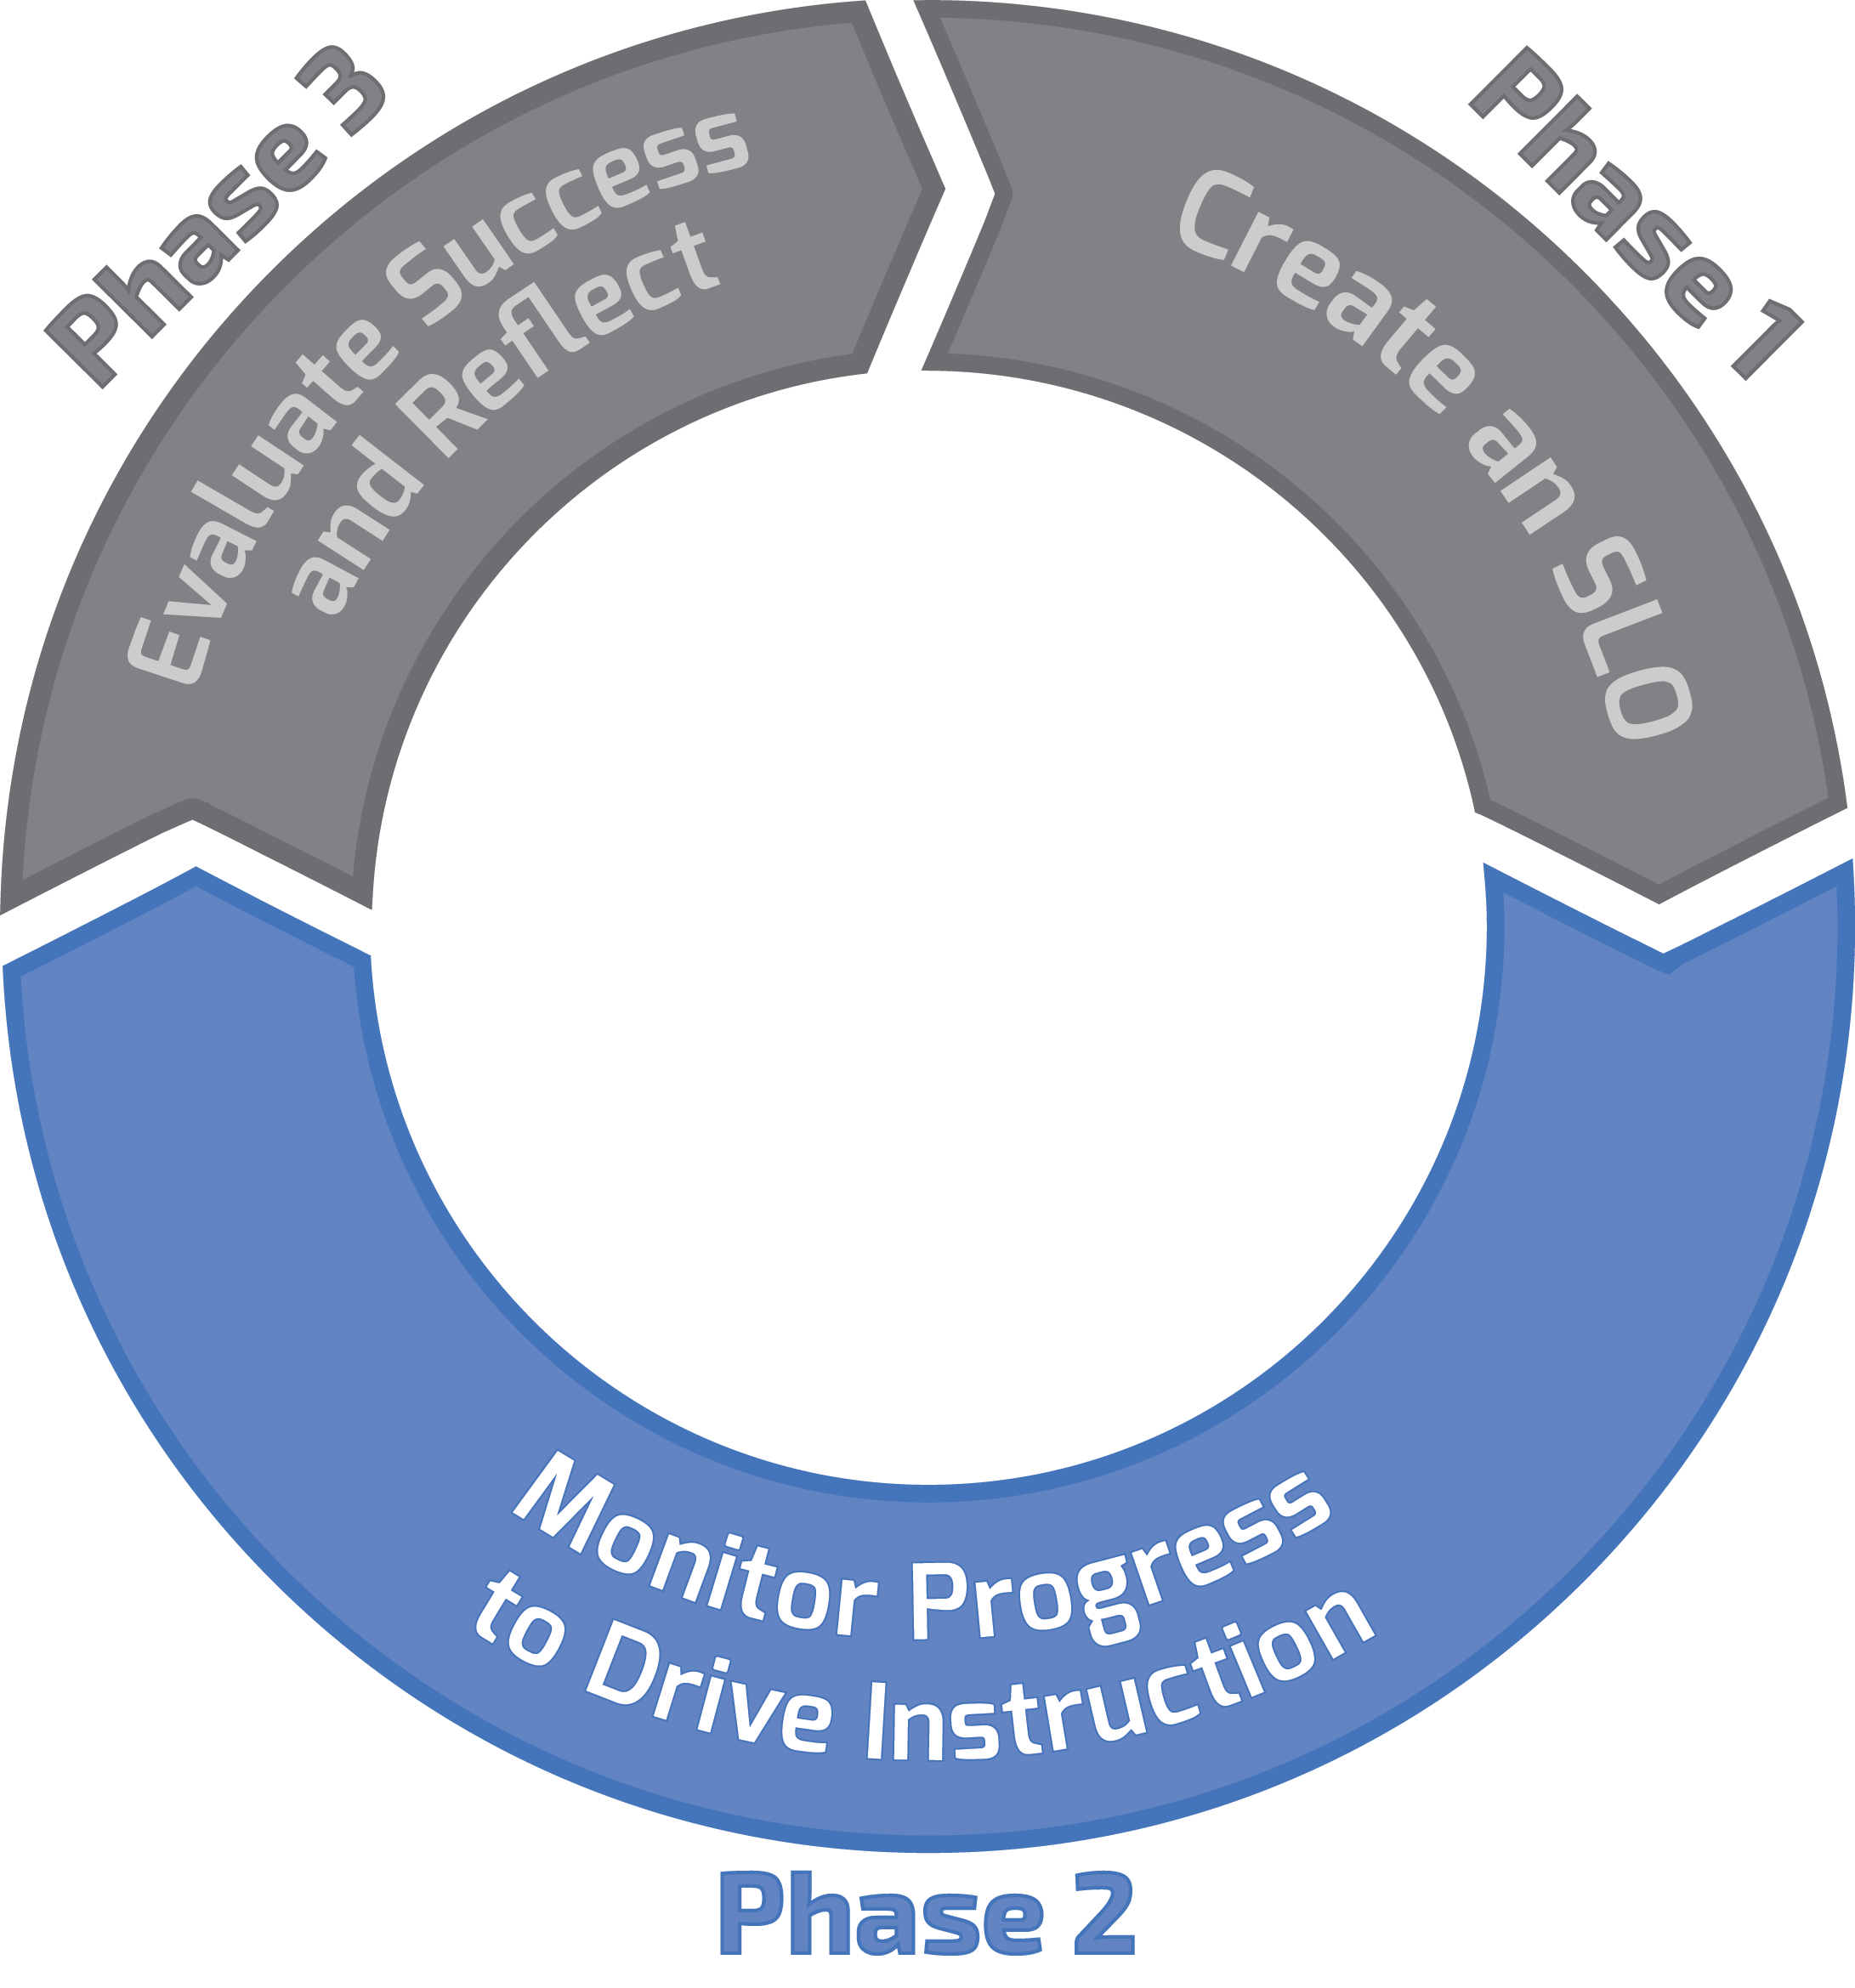
Three Phase Process

Slide 132
Building a Body of Evidence
What student work will you use to track student progress and ultimately determine EOY skill levels?

Slide 133
Phase Two: Monitor Progress and Build the Body of Evidence (BOE)
Q: How do I assess student progress for my SLO?
A: With a robust Body of Evidence (BOE)
133

Slide 134
How will I guide these students towards growth?

Slide 135
Body of Evidence – 2
Define what counts as a quality task/assessment/project in order to be considered part of the BOE
Set minimum number of data points to be included in the BOE, minimum five pieces of student work/evidence per student
Require BOE check-ins at least twice a year with teacher and appraiser
135

Slide 136
Body of Evidence – 3
SLO Skill Statement: Students will be able to draw accurate conclusions supported by appropriate textual evidence from informational texts
Assignment | Part of BOE?
1. In class claim/evidence essay (Sep)
2. “Explain your evidence”
3. “Supporting your claim” short answer
4. Haiku
5. Autobiography
6. In class claim/evidence essay (Feb)
7. Poetry journal
8. In class claim/evidence essay (Apr)
9. Final exam claim/evidence free response
Which assignments should be part of the BOE for this SLO?
136

Slide 137
Body of Evidence
Aligned to the Skill Statement
Measure students’ progress on the foundational skill
Includes assignments/projects/work products that tie directly to the Skill Statement
Does not include student work outside the scope of the foundational skill at the heart of the SLO

Slide 138
Your Turn! – 5
Using the SLO Skill statement, ISP, and TSP that you have written, create a list of assignments/assessments you would use for your BOE
Document on the SLO Form, under TSP, part d
Hint: make sure all assignments align to your Skill Statement!
Be prepared to share examples of your BOE
138

Slide 139
Student Growth Tracker
How will I track student progress/document student work for my SLO?
Notes:
1 min.

Slide 140
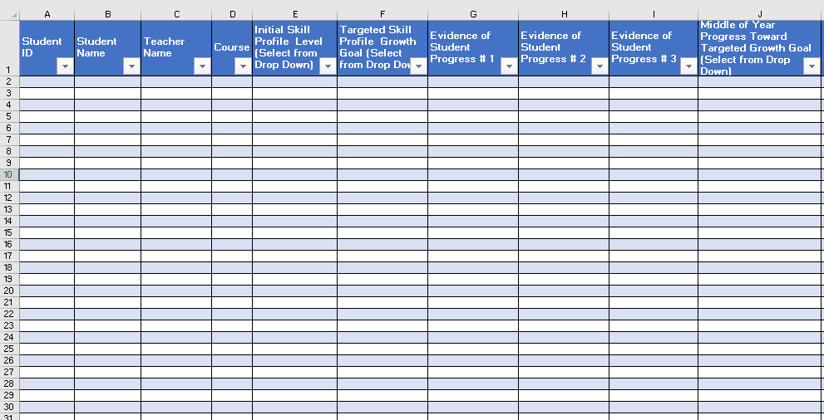
Student Growth Tracker – 2

Slide 141
Student Growth Tracker – 3
Includes:
Initial Skill Profile Level
Targeted Skill Profile Growth Goal
Progress Monitoring Evidence
End of Year Student Skill Level
Representation of Growth
Mastery of assignments/evidence
Scoring 1-5
Scoring %
A-F

Slide 142
Student Growth Tracker – 4
A place to store data on student progress
Numbers are a placeholder for how the student work aligns to the skill descriptors on the TSP
Example: Assignment #1: Adding/Subtracting with Regrouping
What Skills Demonstrated in Student Work | What number goes on the tracker
A student can add/subtract without regrouping but can’t add/subtract with regrouping | The number on the tracker might be a 1 or a 2, because that is how the actual student work aligns to the TSP descriptors for that skill.

Slide 143
Student Growth Tracker – 5

Slide 144
Your Turn! – 6
Open the Excel document
Complete the tracker for 5 sample students
Sources of data from BOE
Complete each column with score that reflects student skill level as it aligns to descriptors in the TSP
Teacher POV
Leader POV
Write down
Extra questions
Areas of greater support
Remember: You are entering numbers, but they are just “stand ins” for how the student work aligns to skill descriptors on TSP. Not about the numbers as much as about the skills.

Slide 145
Getting Students Involved
Guidance
Teacher scripts out full-class investment strategy
Why are we having these conversations?
Why is goal setting important?
Teacher scripts out individual conversations
Explain goal to student (based on data)
Brief conversation to invest student/create individual plan
Record goal
Teacher creates a tracker (example below)
Determine a place for students to record progress towards goals

Slide 146
Success Criteria
a. Plan/Differentiate
Considers highest and lowest skill levels in planning so that all students are supported to meet targeted growth goals
Challenges all students regularly -Uses evidence of student work/skill levels to drive planning
b. Monitor and Adjust
Assesses student progress on SLO at least twice per semester
Assessments are aligned to SLO Skill Statement in content and rigor
Adjusts pedagogy and lesson plans based on assessment results
Compiles a valid and reliable body of evidence of student work, aligned to the Skill Statement
c. Collaborate
Collaborates in order to ensure alignment with district and campus expectations
146

Slide 147
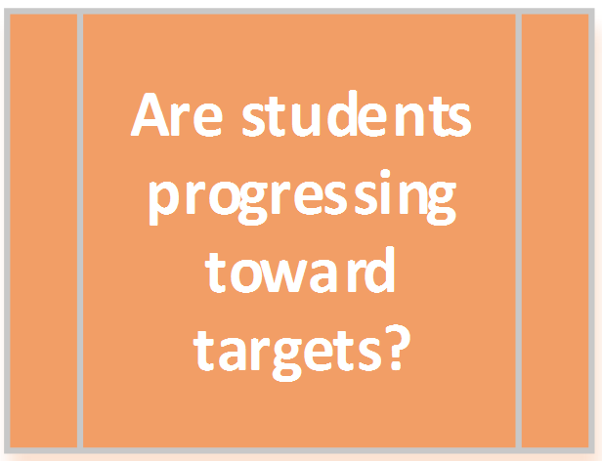
Essential Question
147

Slide 148
Middle of Year Conference – 2
In preparation for the meeting, review:
Student Growth Tracker
Student samples from the Body of Evidence
Data (number of students on track/off track to meet goals)

Slide 149
Determining EOY Skill Levels
Using Student work to determine end of year skill levels

Slide 150
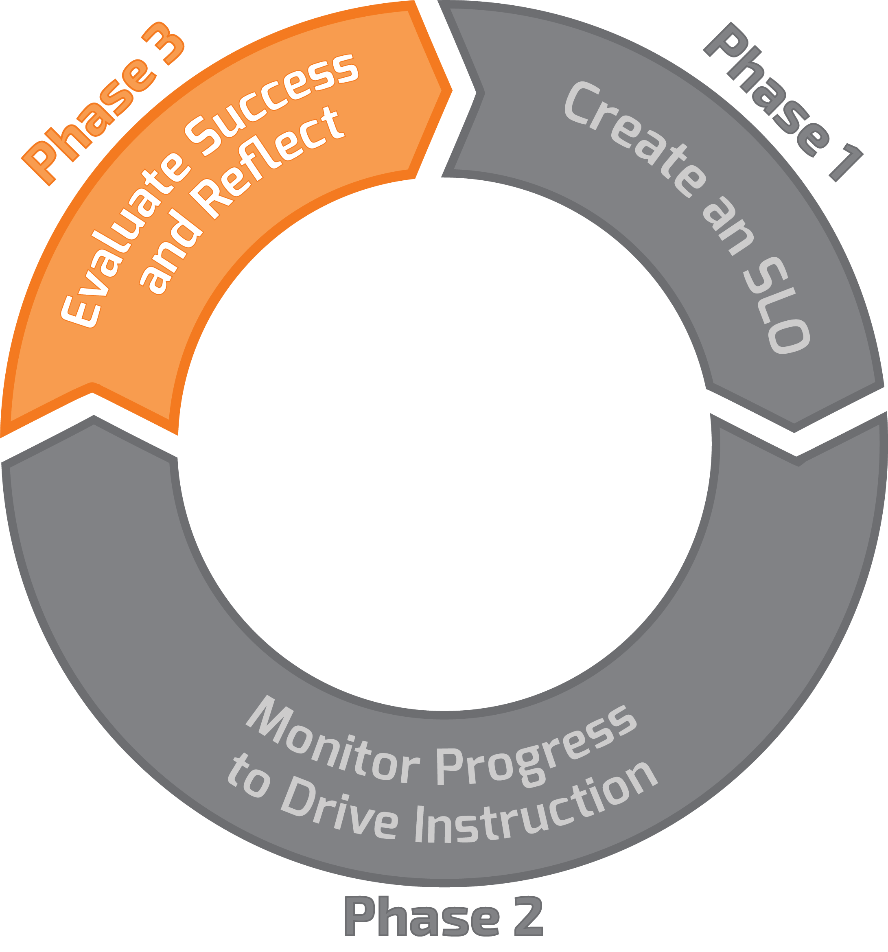
Three Phase Process – 2

Slide 151
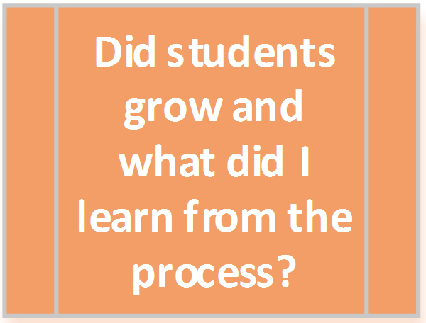
Did students grow and what did I learn from the process?

Slide 152
What are my students’ EOY Skill Levels?
Teachers assess the end-of-year student skill level based on the Body of Evidence.
Based on the BOE, to which skill level on the TSP does each student’s work most closely align?
Student work is used to determine the skill level on the TSP.
Did students meet their targeted EOY skill level?

Slide 153
Let’s go back to 3rd grade math…
Look at student work from EOY.
Based on this work, to which level on the TSP does the work of each student most closely align?

Slide 154
Where would you place the students? – 2
 | Solve 1 and 2-step Mult. and Division word problems #1-#2 | Write the Equation #1-#2 | Justify answer with support #1-#2 | Justify answer w/o support #1-#2 | Write own word problems #3
Elias
Vanessa
Josh
Reina
Maria
3rd Grade Math Students’ ISP Levels
154

Slide 155
Activity – 5
Use these documents:
3rd grade math TSP student work samples
3rd grade Math TSP
Map the students’ EOY skill levels to the TSP based on the skill level shown in their student work
Note: In reality there would be MULTIPLE data sources used, but for today, we are just going to use one sample per student, just to get some practice.
155

Slide 156
Where would you place the students? – 3
 | Solve 1 and 2-step Mult. and Division word problems | Write the Equation | Justify answer with support | Justify answer w/o support | Write own word problems
Elias
Vanessa
Josh
Reina
Maria
3rd Grade Math Students’ ISP Levels
156

Slide 157
Record data and teacher reflection
Teachers record students’ end-of-year skill level on the Student Growth Tracker and complete EOY Reflection in advance of EOY Conference
The SLO EOY close out should occur during the T-TESS EOY conference

Slide 158
End of Year Conference
Reflection on growth data and the SLO process
Take learning from the work and plan for future
Notes:
1 min.
Trainer talk:
The goal of the End of Year (EOY) conference is to consolidate learning about instructional practice and the SLO process, review and reflect on the data. This is also a valuable time to discuss improvements planned for the future so that teachers and administrators can apply learning to planning for the next SLO cycle.

Slide 159
Did students grow and what did I learn from this process?

Slide 160
End of Year Conference – 2
In preparation for the meeting, review:
Completed samples from Body of Evidence
Student Growth Tracker
Percentage calculations of student growth data
SLO Rating Rubric

Slide 161
SLO Teacher Rating Rubric – 2
For use as the student growth component of the district’s appraisal system
Part of a teacher’s summative rating

Slide 162
What we will cover… - 2
Writing Quality SLO Skill Statements
Writing Quality Initial Skill Profiles (ISP)
Matching Students to the ISP
Writing Quality Targeted Skill Profiles(TSP)
SLO Form/Beginning of Year Conference
Collecting a Valid Body of Evidence (BOE)
Student Growth Tracker
SLO Mid-Year Conferences
Determining End of Year Skill Levels Based on BOE
EOY Conferences
162

Slide 163
Closing Reflective Questions
What have you learned from a colleague today?
What are the biggest shifts in this SLO training compared to any previous knowledge you had of the SLO process?
How will you use this training?

Slide 164
Resources Available
texasslo.org
Resources
SLO Administrator Guide
SLO Teacher Guide
Sample SLOs
Orientation
Materials to train staff
Teacher Orientation Manual for orientation
164

